Slide 1


Stealing Browser Cookies: Bypassing the newest Chrome security measures
Red Team Village – DEFCON 33
/
Rafael Félix Offensive Security Lead
08/08/2025

Slide 2


2
Wait, cookies are stored in plaintext?
Encryption Overview
Master Key Extraction
Three Encryption Schemas
Key Derivation Process
Decryption Process
Gecko Decryption Diagram
Webkit-based browsers
The foundation
Binary Structure & Cookie Format
Binary Cookie Diagram
The future of browser security
Device Bound Session Cookies (DBSC)
Possible Attack Vectors
BrowserVoyage – A PoC for decrypting all browsers
Live Demo
Q&A
End
contents
The main issue
Quick info-stealer data analysis
Chromium-based browsers
The evolution of Chrome security
The foundation
Application-Bound encryption architecture
PostProcessData function
Elevator Service Disassembly
State-key decryption
AppBound flow
Cookie format and decryption
On macOS
On Linux
Other Chromium-based
Gecko-based browsers
The foundation
hakai
offensive security

Slide 3


3
$ whoami
Offensive Security Lead with 6+ years in Malware Development & Analysis
> Red Team Engineer specializing in custom offensive tool development;
> Creator of Coffee - a Rust-based COFF loader leveraging BOFs for ease-of-use;
> CVE-2024-21338 PoC (admin-to-kernel Windows driver exploit);
> Windows API internals, EDR bypass techniques, and low-level programming;
> Languages: Rust, C/C++, Go, Python with focus on systems programming;
> Former Malware Analyst with hands-on IR experience and purple team operations;
> Passionate about reverse engineering, exploit development, and hardware security;
Rafael Félix Offensive Security Lead

Slide 4
4
The main issue
1
Info-stealing malware has been a persistent threat;
2
Session-hijacking through cookie theft is more common than ever;
3
Browser vendors are constantly implementing sophisticated security measures;
4
Chrome’s latest security measures have significantly reduced the effectiveness of traditional attacks;

Slide 5

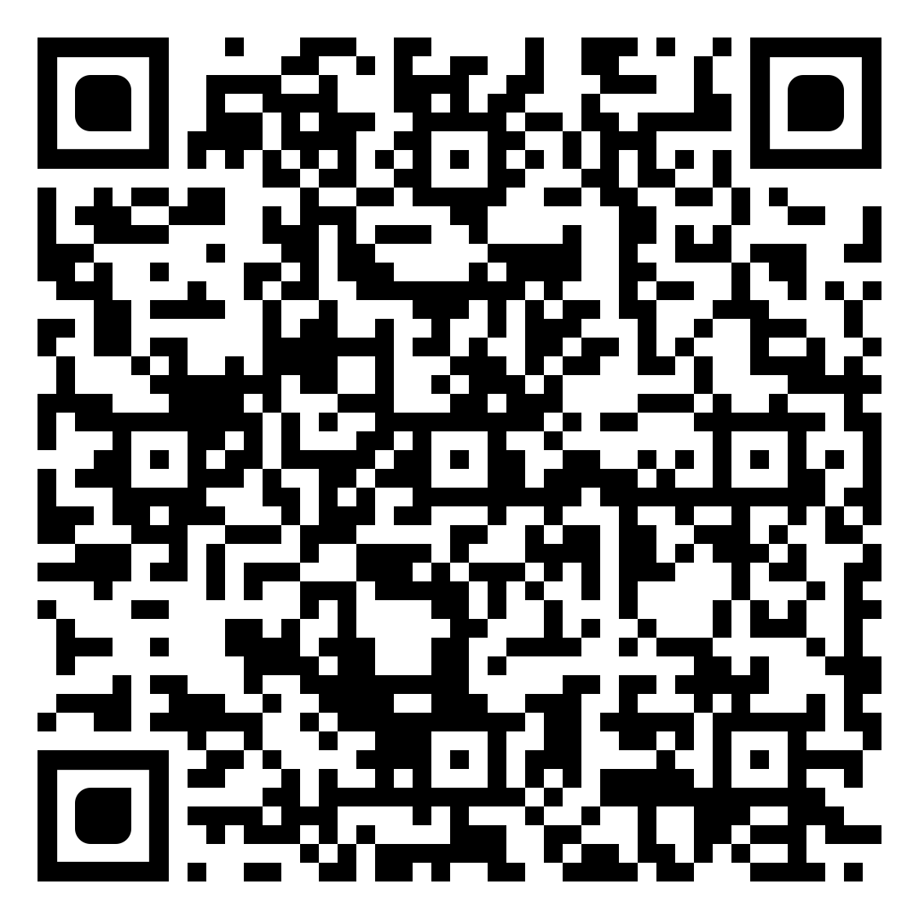
5
Quick info-stealer data analysis
590+ Million Stolen Credentials: What we found
Analyzed stealer logs from 20+ million infected computers worldwide (2019-2024).
Key Numbers:
37% year-over-year growth in credential theft
130M stolen credentials in 2023
179M stolen credentials through Oct 2024
Geographic Leaders:
Brazil: 700K infected machines
India: Close second
Higher development = more digital exposure
Stealer Families:
RedLine: 43% overall dominance
StealC: Leading 2024 with 26%
Lumma: Record September 2024 spike
New variants monthly. These fuel major breaches like TicketMaster.
Full research: https://hakaisecurity.io/stealer-logs-an-in-depth-analysis-of-over-half-a-billion-stolen-credentials/research-blog/

Slide 6



Chromium-based browsers
Blink, blink, how do you encrypt this data?

Slide 7
7
/
The evolution of Chrome security
Near Future
Device Bound Session Cookies (DBSC)
2024~2025
Changes between AES-256-GCM and ChaCha20Poly1305 (Chrome)
2015~2020
DPAPI Integration
2020~2023
AES-256-GCM encryption
2023~2024
AppBound encryption (Chrome)

Slide 8
8
The foundation
Cookie Location:
Windows: %LOCALAPPDATA%\Google\Chrome\User Data\Default (Or Profile)\Network\Cookies;
macOS: ~/Library/Application Support/Google/Chrome/Default (Or Profile)/Cookies;
Linux: ~/.config/google-chrome/Default (Or Profile)/Cookies;
Database Format: SQLite3 with cookies table containing host_key, name, encrypted_value columns;
Master Key Location: %LOCALAPPDATA%\Google\Chrome\User Data\Local State → os_crypt.encrypted_key;

Slide 9
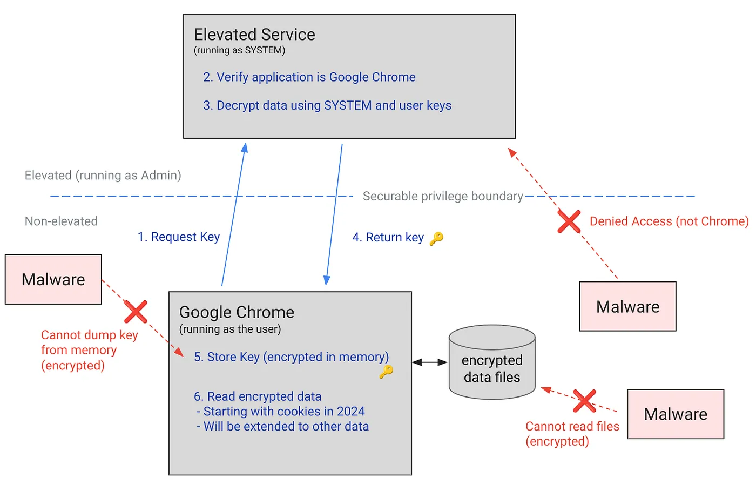
9
Application-Bound encryption architecture
Requires Administrator privileges to run
Needs to use SeDebugPrivilege to access LSASS process
Needs to impersonate LSASS token to gain SYSTEM privileges
Needs to duplicate LSASS token with SecurityImpersonation level
Needs to set current thread token to impersonated SYSTEM token
SYSTEM DPAPI decrypt of app_bound_encrypted_key from Local State
User DPAPI decrypt of the result from SYSTEM decrypt
Process involves two-stage DPAPI decryption (SYSTEM then user)

Slide 10
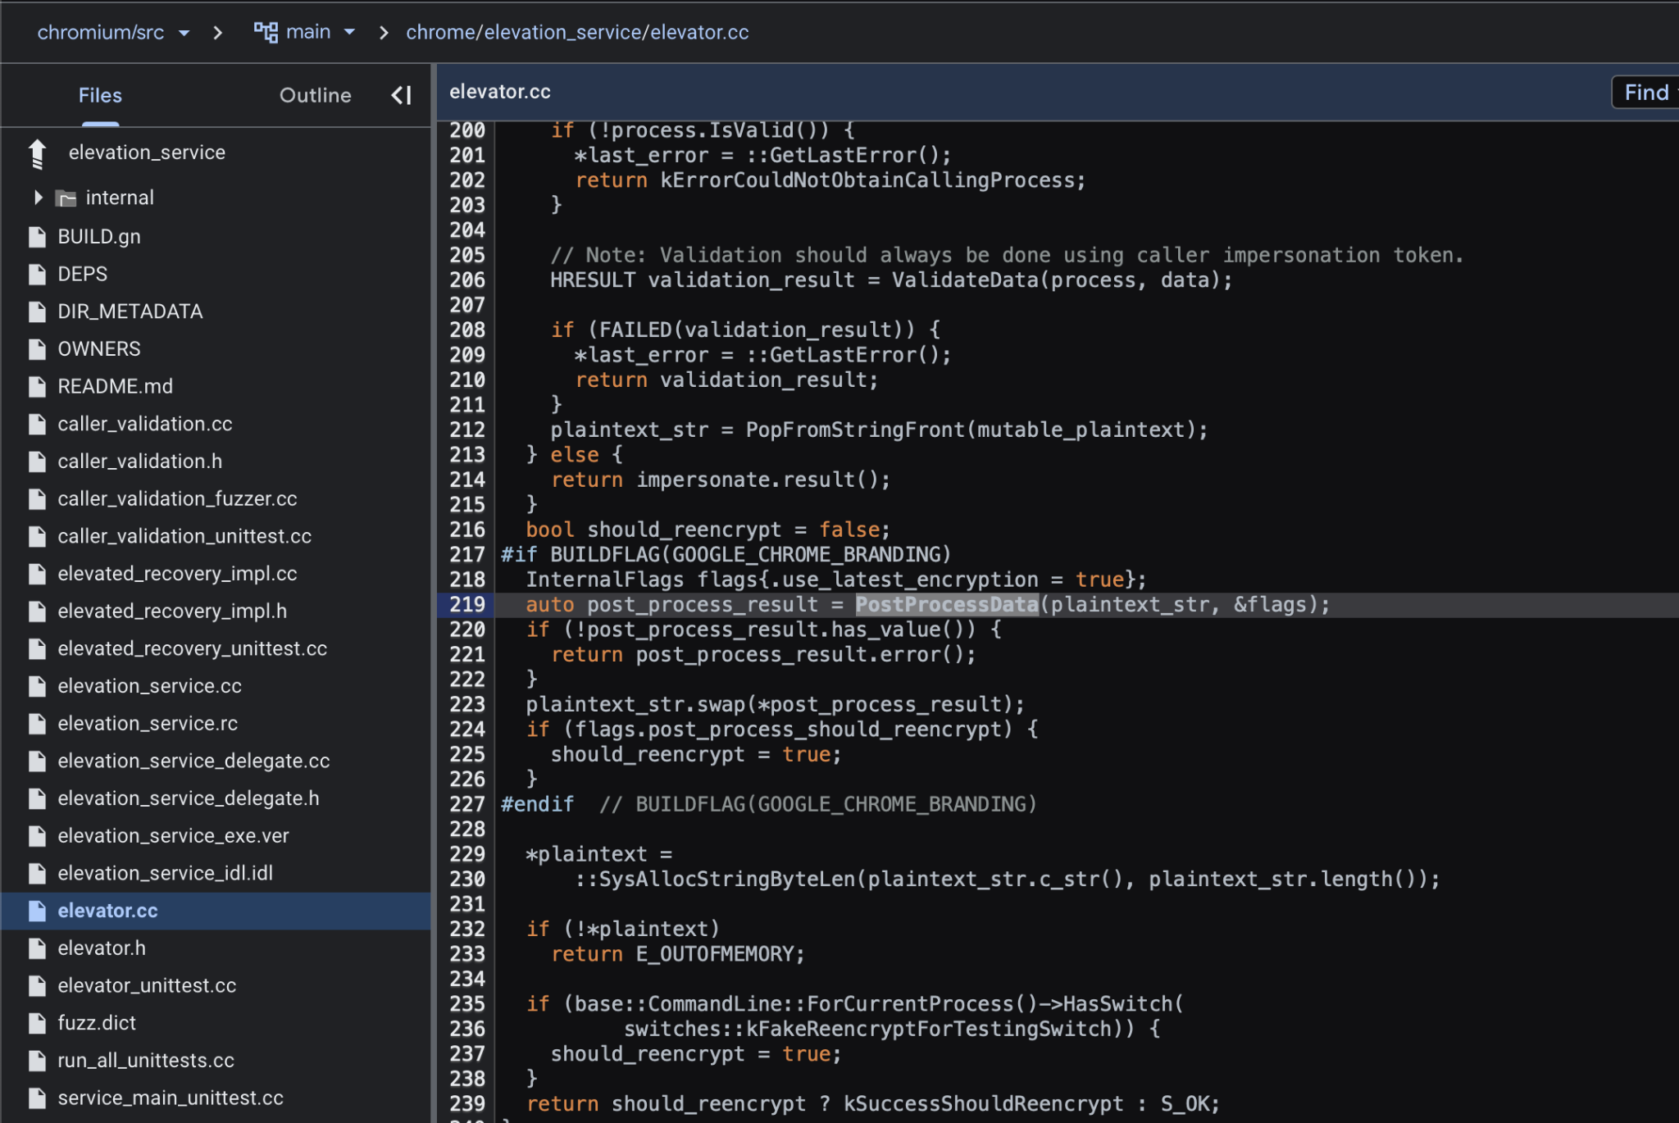
Md76pcdJt886KRkiWhmbPz6r^GWA%mkD
10
PostProcessData function
This is where the magic happens
Located on chromium/src/chrome/elevator.cc;
Google Chrome branding specific;
Internal flags control algorithm selection;
PostProcessData, a function that processes the encryption of data passed to it: (https://source.chromium.org/chromium/chromium/src/+/main:chrome/elevation_service/elevator.cc;l=219)

Slide 11
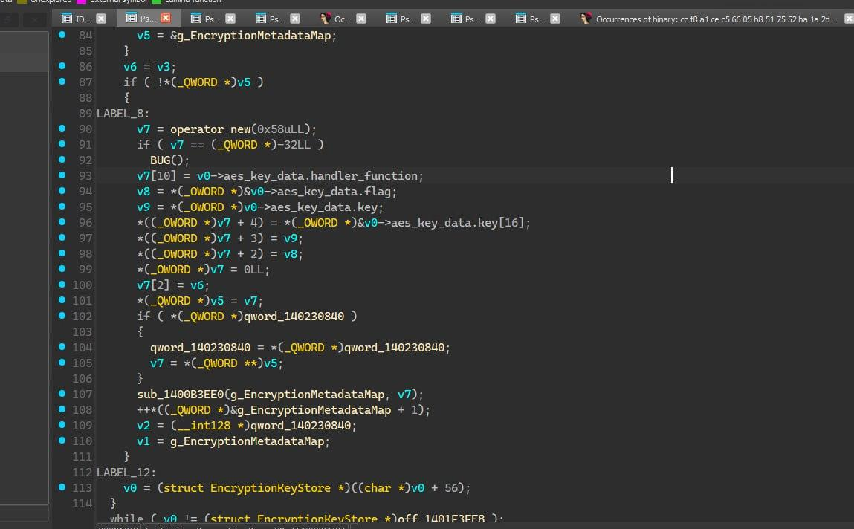
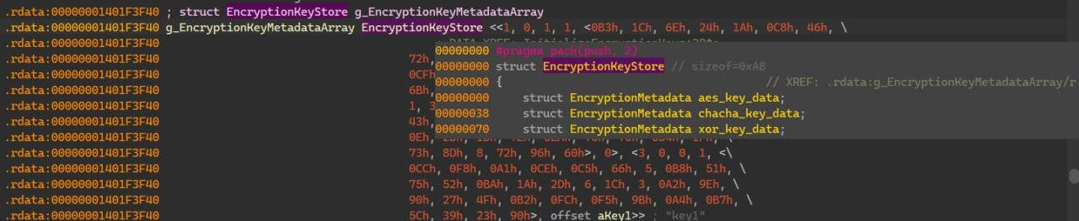
Md76pcdJt886KRkiWhmbPz6r^GWA%mkD
11
Elevator Service Disassembly
Keys location on elevation service, stored in order from AES to XOR keys.
Key initialization function, gets triggered on a class constructor.

Slide 12
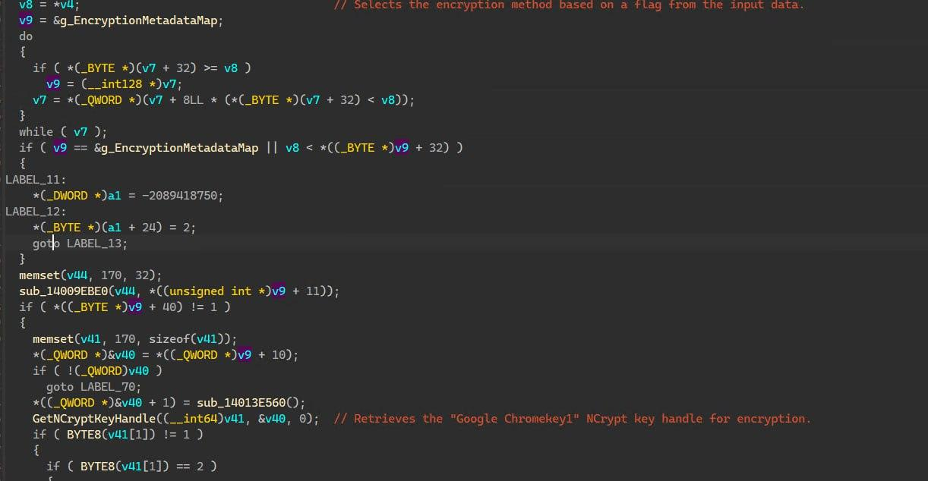
Md76pcdJt886KRkiWhmbPz6r^GWA%mkD
12
Elevator Service Disassembly
EncryptData function, gets called inside the PostProcessData function, contains the algorithm selection and state-key encryption itself.

Slide 13
13
State-key decryption
Parse key blob: [4-byte header length][header data][4-byte content length][content data];
Flag byte at start of content data after length fields;
Flag Type 1: Uses hardcoded AES key with GCM mode (format: [1-byte flag][12-byte IV][32-byte ciphertext][16-byte tag]);
Flag Type 2: Uses hardcoded ChaCha20Poly1305 key (format: [1-byte flag][12-byte IV][32-byte ciphertext][16-byte tag]);
Flag Type 3: CNG decrypt encrypted AES key, XOR process with hardcoded key (format: [1-byte flag][32-byte encrypted AES key][12-byte IV][32-byte ciphertext][16-byte tag]);
Decrypt and verify ciphertext+tag to get v20 master key;
Master key used for AES-256-GCM cookie decryption achieved;

Slide 14
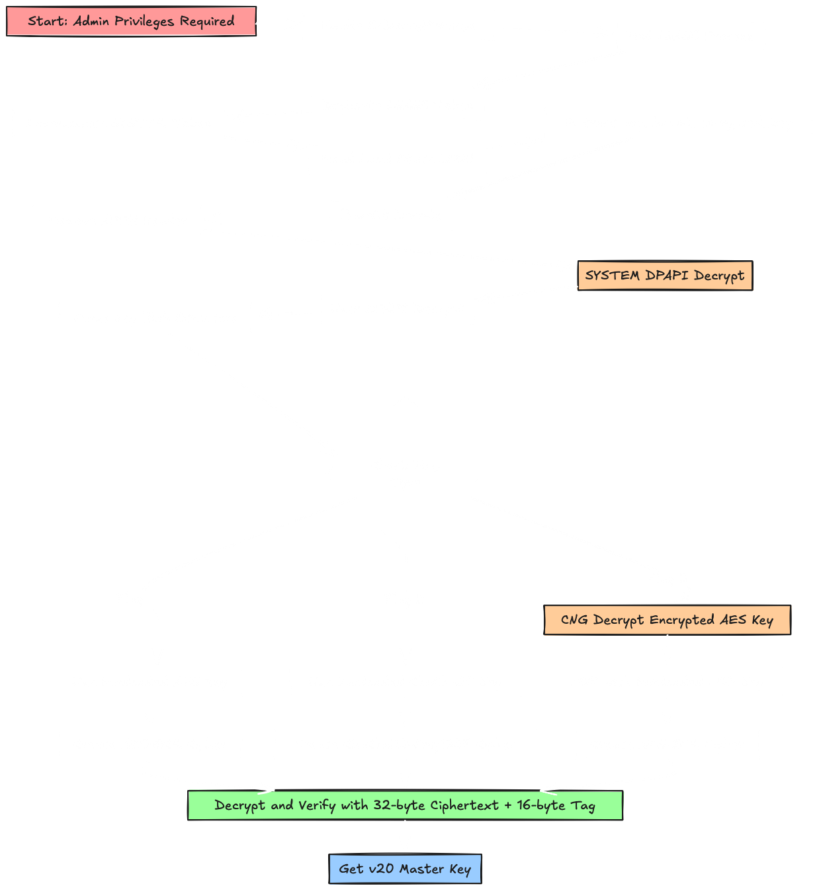
14
AppBound flow

Slide 15
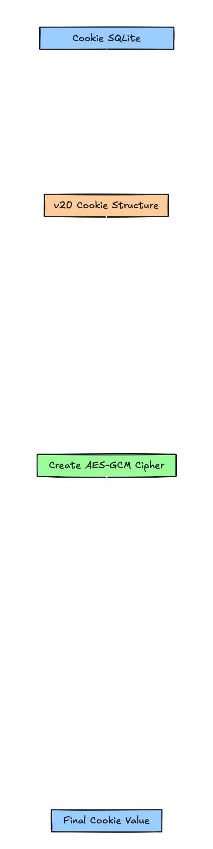
15
Cookie format and decryption
Connect to Cookies SQLite database in read-only mode;
Query for cookies where encrypted_value starts with "v20" prefix;
Cookie structure: [3-byte "v20" (can also be “v11” or “v10” for older cookies)][12-byte IV][variable ciphertext][16-byte tag];
Create AES-GCM cipher using previously obtained master key;
Use extracted 12-byte IV as nonce for AES-GCM;
Decrypt and verify ciphertext with 16-byte authentication tag;
Skip first 32 bytes of decrypted result (hostkey for ≥24);
Decode remaining bytes as UTF-8 to get final cookie value;
For database versions ≥24: decrypted payload contains SHA-256 hash of domain followed by cookie value;
Repeat!

Slide 16
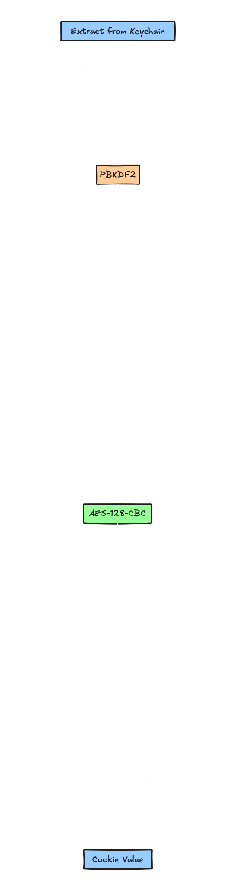
16
On macOS
Extract encryption passphrase from macOS Keychain under "Chrome Safe Storage"
Use PBKDF2 with fixed salt "saltysalt" and 1003 iterations to derive AES-128 key
Connect to Chrome's Cookies SQLite database in read-only mode
Query for cookies where encrypted_value starts with version prefix ("v10", "v11", etc.)
Cookie structure: [version prefix][AES-128-CBC encrypted data with PKCS7 padding]
Create AES-128-CBC cipher using derived key and fixed IV of 16 space characters (0x20)
Remove version prefix (typically 3 bytes) before decryption
Decrypt ciphertext and remove PKCS7 padding from result
For database versions ≥24: decrypted payload contains SHA-256 hash of domain followed by cookie value
Decode remaining bytes as UTF-8 to get final cookie value
Process repeats for each encrypted cookie in database

Slide 17
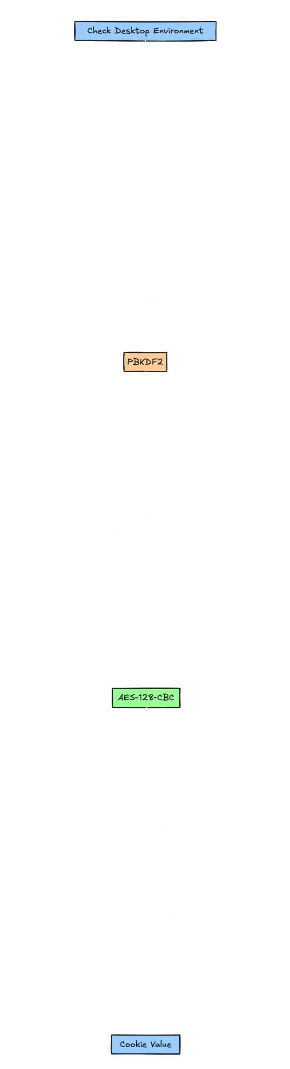
17
On Linux
Extract encryption passphrase from GNOME Keyring/KWallet under "Chrome Safe Storage" (or use "peanuts" if no keyring)
Use PBKDF2 with fixed salt "saltysalt" and 1 iteration to derive AES-128 key
Connect to Chrome's Cookies SQLite database in read-only mode
Query for cookies where encrypted_value starts with version prefix ("v10", "v11", etc.)
Cookie structure: [version prefix][AES-128-CBC encrypted data with PKCS7 padding]
Create AES-128-CBC cipher using derived key and fixed IV of 16 space characters (0x20)
Remove version prefix (typically 3 bytes) before decryption
Decrypt ciphertext and remove PKCS7 padding from result
For database versions ≥24: decrypted payload contains SHA-256 hash of domain followed by cookie value
Decode remaining bytes as UTF-8 to get final cookie value
Fallback modes: basic (unencrypted), gnome (GNOME keyring), kwallet (KDE wallet)

Slide 18
18
Other Chromium-based
PostProcessData is a branded implementation (GOOGLE_CHROME_BRANDING macro), so only Chrome does this way;
Brave and Edge (Chromium version) inherit the raw DPAPI with AppBound, no fancy state-key encryption (get the last 32 bytes of the decrypted result for the state key);
Accounts? Same encryption.

Slide 19
Gecko-based browsers
How do they encrypt browser data? 🦎 Edition

Slide 20
20
The foundation
Cookie Location:
Windows: %APPDATA%\Mozilla\Firefox\Profiles\<profile>;
macOS: ~/Library/Application Support/Firefox/Profiles/<profile>/;
Linux: ~/.mozilla/firefox/<profile>/;
Cookie storage in cookies.sqlite SQLite database with moz_cookies table;
Account storage in logins.json JSON file with Base64-encoded encrypted credentials;
Master key data stored in key4.db SQLite database (metadata and NSS private tables);
No centralized "Local State" file like Chromium browsers;
Profile-based architecture with individual profile directories;
Cookies stored in PLAIN TEXT (no encryption applied);
Only saved login accounts/passwords are encrypted;
Multi-profile support with separate encryption keys per profile;

Slide 21
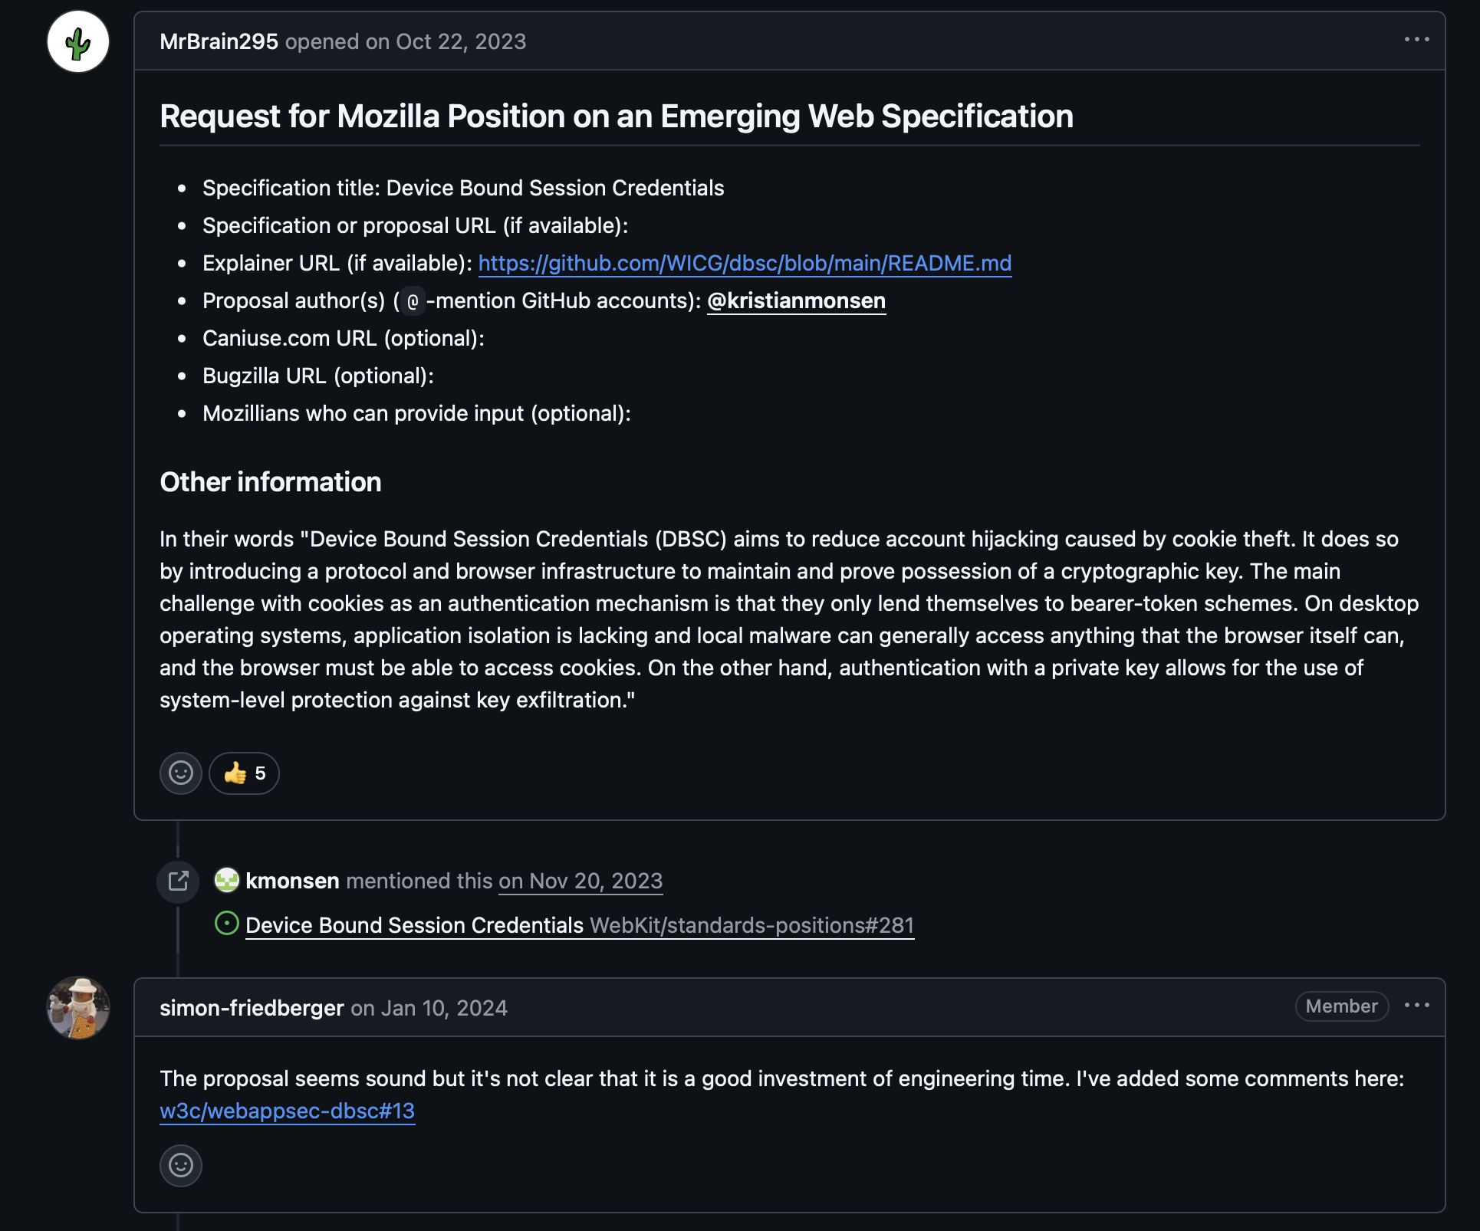
21
Wait, cookies are stored in plaintext?

Slide 22
22
Encryption Overview
Firefox stores credentials in two main locations:
key4.db → Containing the encrypted master key
logins.json → Containing encrypted usernames/passwords
Encryption flow:
Master Password → Master Key → Individual Credential Keys → Plaintext
Each credential encrypted separately with unique salt
Three different encryption methods supported (legacy + modern)

Slide 23
23
Master Key Extraction
1: Extract from key4.db database
global_salt (used for all key derivations)
encrypted_validation (contains "password-check" string)
encrypted_master_key (the actual key we want)
validation_constant (must equal specific value)
2: Validate database integrity
Decrypt validation data → must contain "password-check"
Check validation constant → must equal KEY_LIN
3: Extract final master key
Decrypt master key using global_salt
Take first 24 bytes as final encryption key

Slide 24
24
Three Encryption Schemas
ASN.1 Structure:
[algo_id][salt_data][enc_payload]
NssPBE (Legacy 3DES):
Algorithm: 3DES-EDE3-CBC
Key Derivation: Custom HMAC-SHA1 chain
Key Size: 24 bytes, IV Size: 8 bytes
MetaPBE (Modern AES):
Algorithm: AES-256-CBC
Key Derivation: PBKDF2-HMAC-SHA256 (100k+ iterations)
Key Size: 32 bytes, IV Size: 16 bytes
LoginPBE (Simple 3DES):
Algorithm: 3DES-EDE3-CBC
Key: Global salt used directly
Simpler structure, less secure

Slide 25

25
Key Derivation Process
Legacy (HMAC Chain):
composite_hash = SHA1(SHA1(global_salt) + entry_salt)
Multiple HMAC operations create 40-byte result
Split into 24-byte key + 8-byte IV
Modern (PBKDF2):
base_password = SHA1(global_salt)
PBKDF2-HMAC-SHA256(base_password, entry_salt, 100k+ iterations, 32 bytes)
IV constructed separately from ASN.1 data

Slide 26
26
Decryption Process
1: Parse credential data
Read logins.json → Extract Base64 encoded credential blobs
Decode Base64 → Get raw ASN.1 structure
Parse ASN.1 → Identify encryption schema and extract salt
2: Generate decryption key
Apply appropriate key derivation (HMAC chain or PBKDF2)
Use global_salt + extracted entry_salt
Generate encryption key and IV
3: Decrypt and validate
Apply block cipher (3DES-CBC or AES-256-CBC)
Remove PKCS#7 padding from result
Convert bytes to UTF-8 strings
Result: Plaintext username and password
Each field encrypted independently (separate salts)

Slide 27

27
Gecko Decryption

Slide 28
Webkit-based browsers
How do they encrypt/decrypt browser data?

Slide 29
29
The foundation
Cookie Location:
macOS: ~/Library/HTTPStorages/*.binarycookies (For applications using WebKit)
macOS: ~/Library/Containers/com.apple.Safari/Data/Library/Cookies/Cookies.binarycookies (For Safari)
Cookie storage in binary cookies file format;
Account storage in keychain, more complex exploitation;
Cookies stored in PLAIN TEXT (no encryption applied, trivial attack complexity);

Slide 30
30
Binary Structure & Cookie Format
File Structure:
Magic: "cook" [99,111,111,107] → Page Count → Page Sizes Array
Per Page: Start Code [00,00,01,00] → Cookie Count → Cookie Offsets → End Code [00,00,00,00]
Cookie Record (44-byte header + strings):
Size (4) + Unknown (4) + Flags (4) + Unknown (4)
Domain/Name/Path/Value/Comment Offsets (4 bytes each)
End Header [00,00,00,00] (4)
Expiry Time (8) + Creation Time (8)
Variable strings: null-terminated domain, name, path, value, comment
Flags: 0x00=none, 0x01=secure, 0x04=httponly, 0x05=both
Timestamps: Mac format (add 978307200 for Unix epoch)

Slide 31

31
Binary Cookie Diagram

Slide 32
The future of browser security
(Un)welcome DBSC! :(:

Slide 33

33
Device Bound Session Cookies (DBSC)
What is DBSC?
Hardware-backed session security using TPM;
Cryptographic key pair associated with user’s device;
Short-lived cookies with automatic refresh;
Proof of possession required for cookie renewal;
The user needs to have a computer compatible with TPM;

Slide 34

34
Possible attack vectors
TPM Key Extraction –
Requires physical access or malware with administrative access;
Extract private key from TPM storage;
Virtual Memory Extraction –
Extract private key from Chrome’s memory space;
Requires process injection or memory dumping;
Malware during registration process –
If a malware is present during the session registration it can extract the private key as it’s generated;
TPM Driver Modification –
Modify the TPM kernel driver to bypass the hardware protection, significantly more complex though;
More information about DBSC

Slide 35



/
BrowserVoyage
Rust project implementing everything mentioned on this presentation;
Acts as a crate so you can implement it on your Rust project too;
A tactic will happen at 2 PM where I can help attendees closely;

Slide 36
/
Live Demo Time!

Slide 37
/
08/08/2025
> Thank you!
> hakaisecurity.io
> linkedin.com/in/~biscoito
hakai
offensive security

